Slide 1
SALES ANALYSIS
2001 Q3 – 2004 Q3

Slide 2
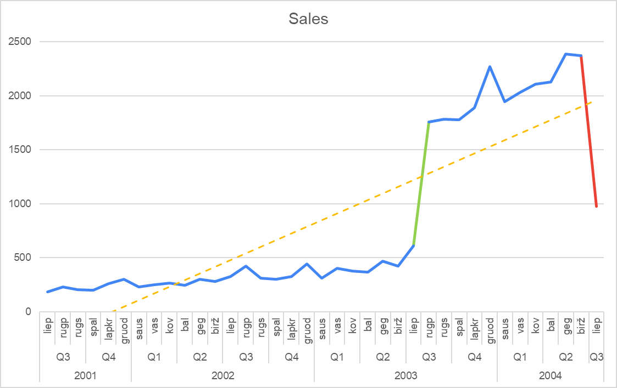
MONTHLY SALES TREND
Overall sales trend 2001 Q3 – 2004 Q3: Growing sales
OUTLIERS:
High growth during 2003 August
Significant decrease during June 2004

Slide 3
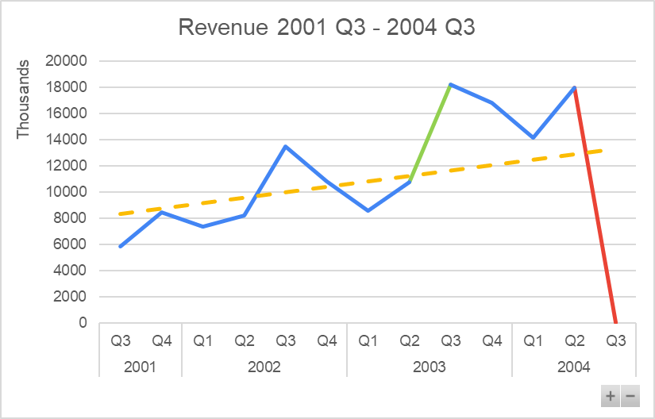
MONTHLY REVENUE TREND
Overall Revenue trend 2001 Q3 – 2004 Q3: Growing revenue, not as rapidly as volume of sales
OUTLIERS:
High growth during 2003 August
Significant decrease during June 2004

Slide 4
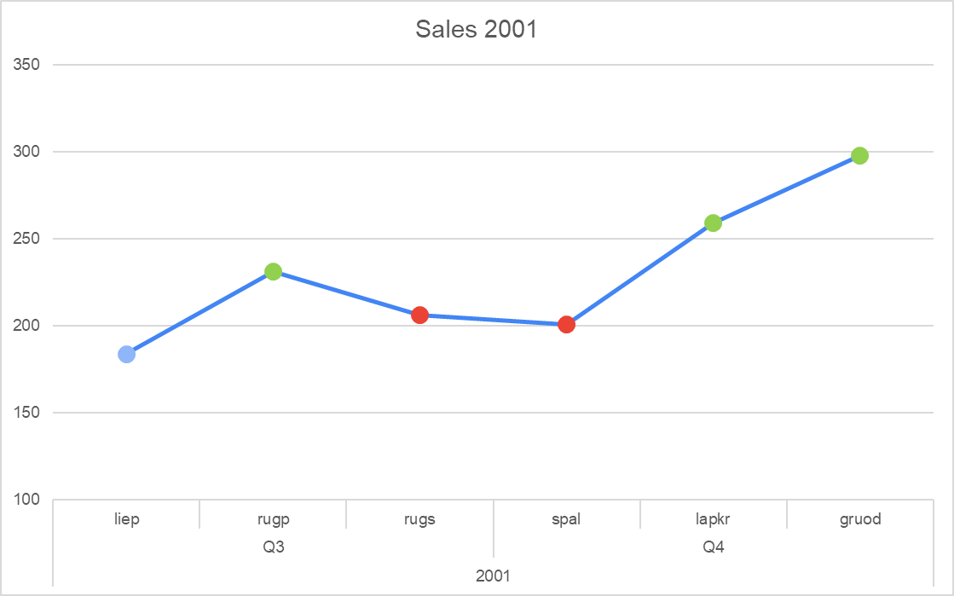
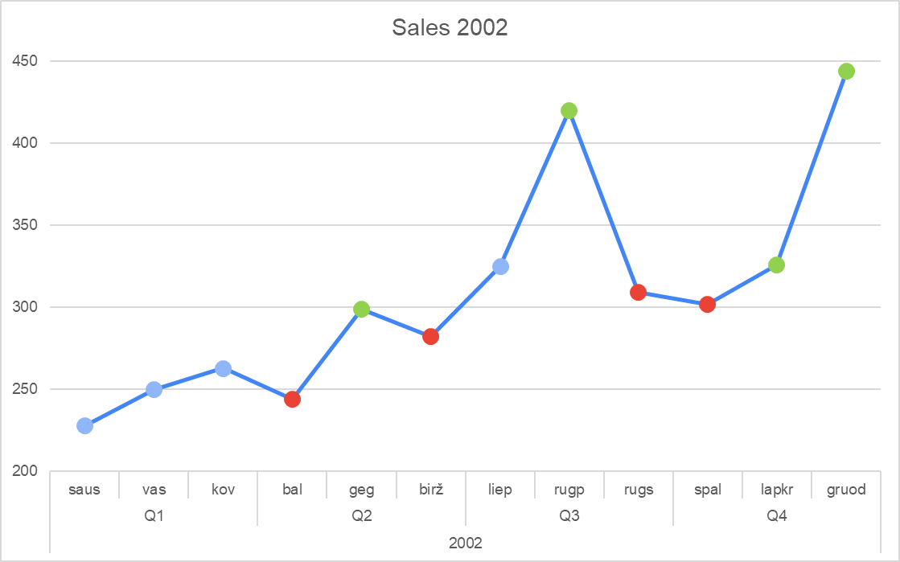
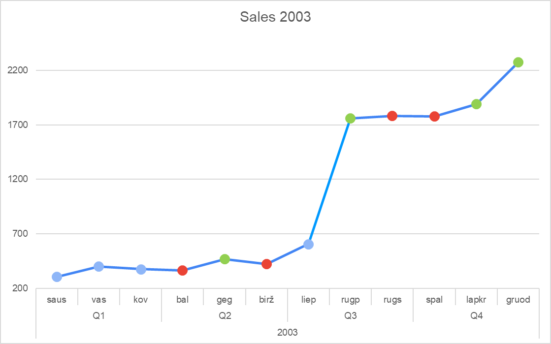
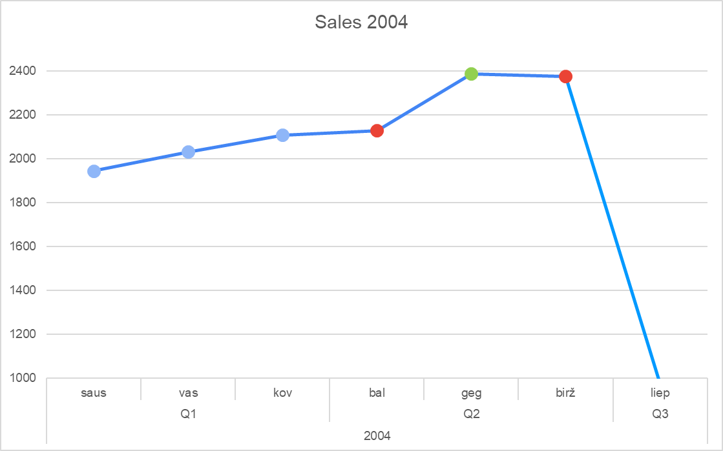
SEASONALITY OF SALES
LOW GROWTH/DECREASE
April
June
September
October
HIGH GROWTH
May
August
November
December

Slide 5
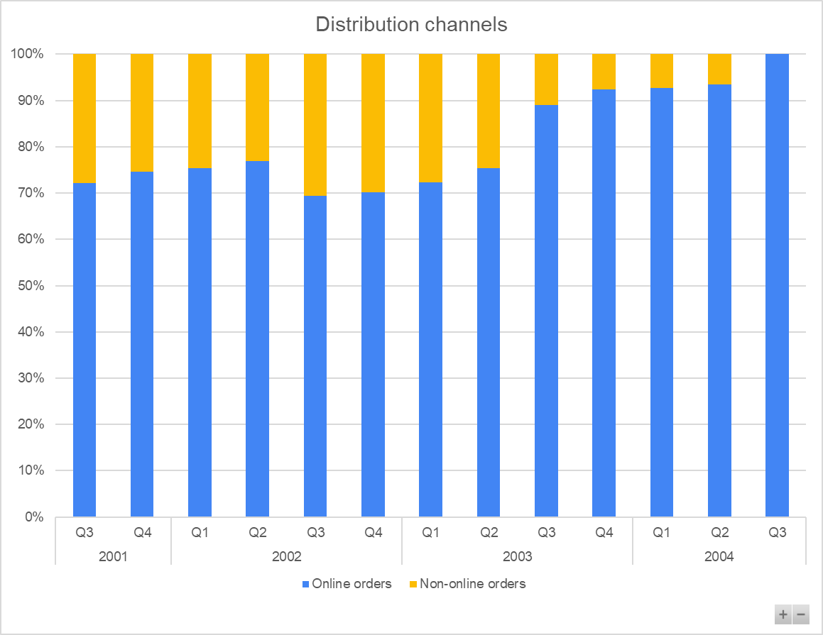
DISTRIBUTION CHANNELS
ONLINE STORES
PHYSICAL ORDERS
Main distribution channel: more than 70% of sales are generated online
Shows gradually decreasing trend.
0 non-online orders during the major drop in sales for Q3 2004

Slide 6
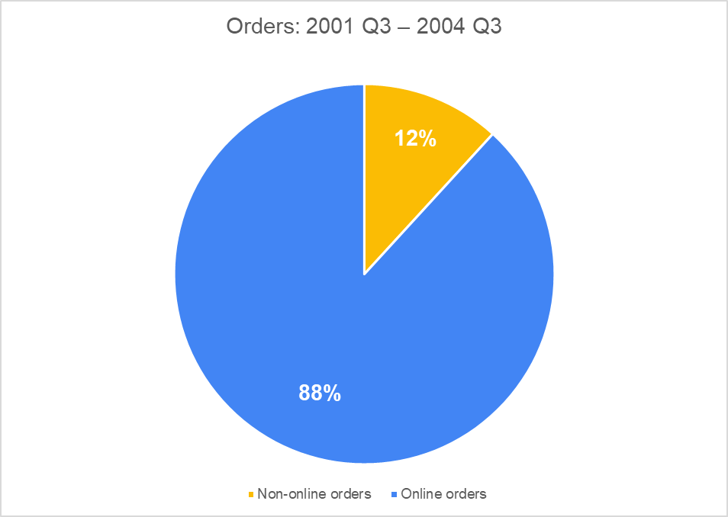
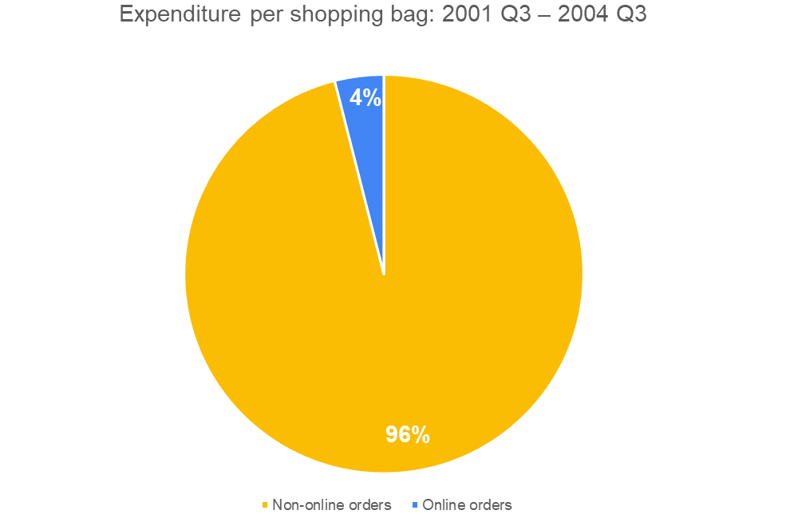
EXPENDITURE PER CHANNEL
ONLINE ORDERS
NON-ONLINE ORDERS
Are the most popular among clients.
Generates most of the revenue per shopping bag

Slide 7
7
DAYS DELIVERY
NO LATE SHIPMENTS

Slide 8
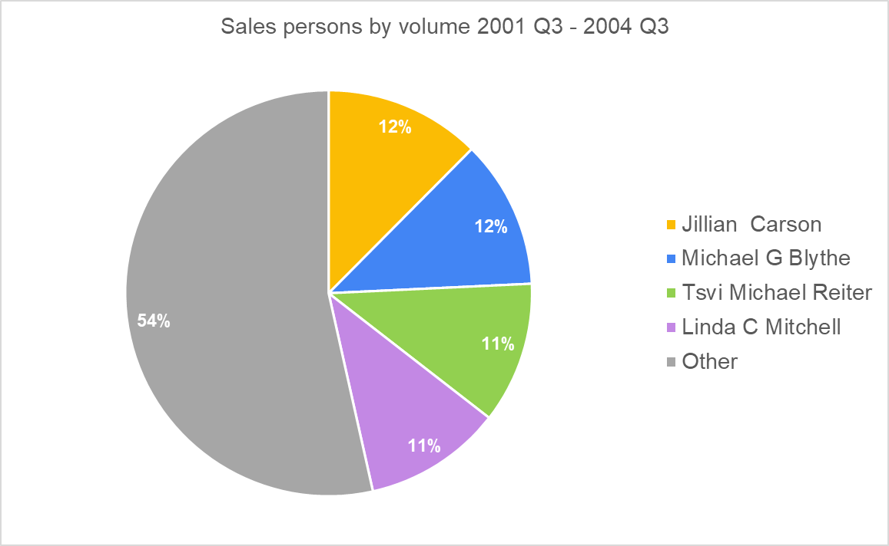
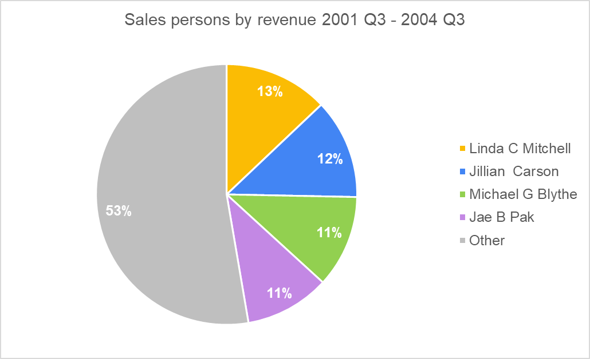
SALES PEOPLE
Highest volume
Highest revenue
Jillian Carson
Linda C Mitchell

Slide 9
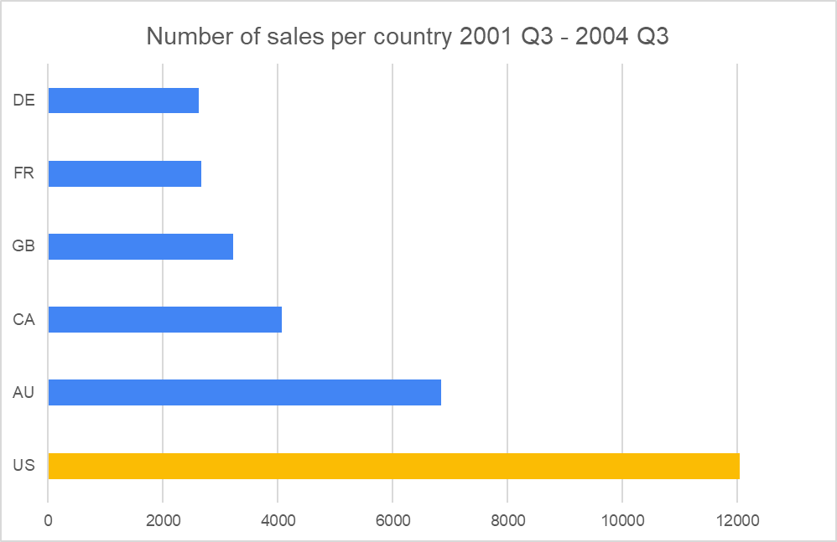
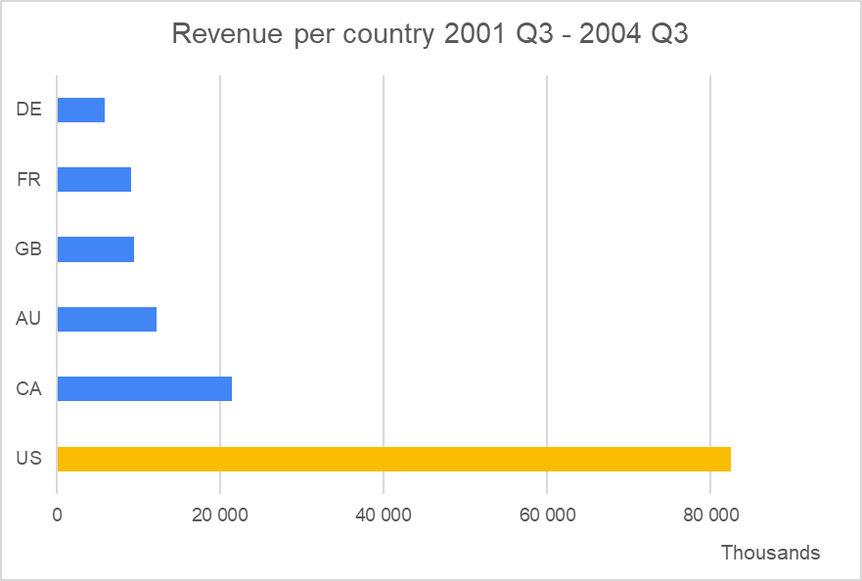
SALES PER COUNTRY
Target Maret
US
Most sales are made in the US & most revenue is generated there

Slide 10
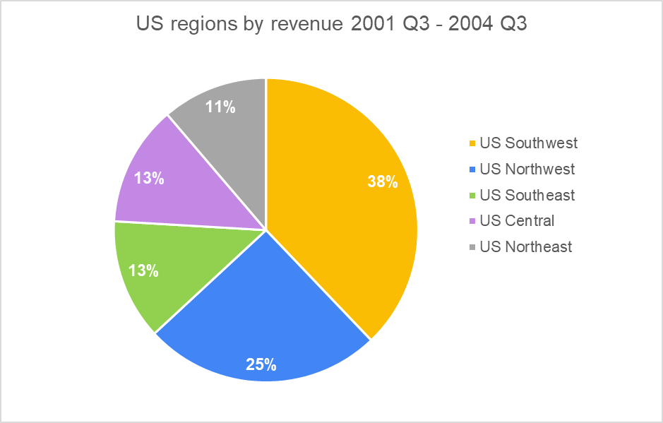
US SALES BY REGION
US Southwest & Northwest
Performing the best by generated revenue

Slide 11
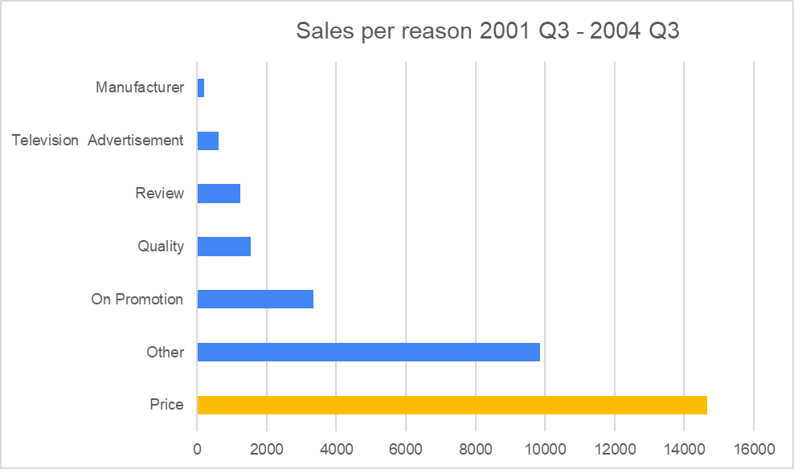
REASONS FOR SALES
Price
Is the most valued quality of the current customer followed by promotion

Slide 12
CONCLUSIONS
01
02
03
04
05
06
SALES
SEASONALITY
SALES CHANNELS
Upward trend, high growth during 2003 Q3 -2004 Q2. Huge drop in 2004 Q3.
Higher demand during May, August, November, December.
Higher # of orders online, yet higher revenue per basket on non-online orders. 0 physical orders 2004 Q3.
DELIVERY
SALES PEOPLE
TARGET MARKET
Constant trend with 7 days of delivery. No late shipments.
Top 4 sales people generate almost half of the non-online orders revenue.
US market, specifically Southwest & Norhwest region. Product value feature: Price.

Slide 13
RECOMMENDATIONS
01
02
03
04
05
06
SALES
SEASONALITY
SALES CHANNELS
Return non-online orders which were 0 in 2004 Q3.
Higher inventory/capacity should be available during May, August, November, December.
Differenciate targeting strategies for online and non-online customers.
DELIVERY
SALES PEOPLE
TARGET MARKET
Reduce shipment time.
Bonus system by generated revenue.
To strengthen competitive position: more promotion in US region. Highlight price as benefit for the product.

